Slide 1
Regulatory Reporting
www.pwc.co.uk
Trade and transaction reporting review
Morgan Stanley
Our proposal response to you Regulatory Reporting RFP
July 2016

Slide 2
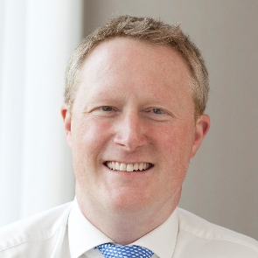
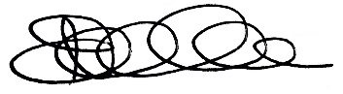
A personal message from Nick Bouch
Partner
“We are able to deploy a uniquely experienced global team who have worked together within each territory to repeatedly to help clients understand and overcome the complex trade and transaction reporting challenges they may often face.”
Thank you for inviting PwC to respond to your Request for Proposal to support your regulatory trade and transaction reporting review.
Your immediate goal is to evaluate the currently implemented reporting processes, rule interpretations and the regulatory reporting control framework across the transaction reporting environment supported by Herald and RDRS – specifically for derivative product reporting within rules issued by the Commodity Futures Trading Commission (“CFTC”) (Parts 43, 45, 46) and under the European Market Infrastructure Regulation (“EMIR”).
As part of a further potential phase of work you have also indicated that you are seeking to complete the same activity across both derivatives and cash products for MIFID I, ASIC, CSA, JFSA, MAS, HKMA and Israeli trade and transaction reporting rules.
We appreciate, based on our relevant experience with organisations that you would view as your peers, that work of this complexity for both EMIR and CFTC rules requires a blend of regulatory, governance and data analytics skills. As the leader of our UK Banking & Capital Markets Advanced Risk & Compliance Analytics practice and Engagement Partner on a number of similar engagements over the last 12 months I have chosen to lead the team. We understand that this is a important engagement for Morgan Stanley (“MS”) and you are an important client to PwC and will also be to me personally.
I have pulled together a global team which I consider to be the best possible team to partner with you to deliver against your requirements. Importantly I will be supported by Frank Badalamenti in the US who has supported many clients, including MS, in matters related to regulatory trade reporting, trade execution and allocation.
Day-to-day the team will be led on the ground by Neil Douglas; Neil comes with over 15 years of investment banking experience specifically in OTC derivatives and has been the lead on a recent US bank EMIR engagement with myself as well as the lead for a s166 transaction reporting review for one of your other US peers.
Many of the other UK and US senior and junior team members have deep experience in running and developing transaction reporting programmes, including EMIR and CFTC rules for two other peers in the last nine months, and bring a perspective and understanding of the technical requirements and the wider industry and regulatory landscape to provide insight on the your transaction reporting processes.
Our wider Firm, in the UK and globally, really is unparalleled with respect to derivative transaction reporting; I am committed to bringing you insights from across our Firm to make sure we manage the review with precision, deliver quality outputs, make practical recommendations and provide added value throughout.
Along with our deep experience on similar engagements we will make sure our SMEs, many of whom come from the regulatory agencies, are available to support you and the team as well as utilising a number of our accelerators and tools including our regulatory inventories, our transaction reporting diagnostic tool including CFTC and EMIR rules and our data lineage capabilities.
How we carry out the review is of upmost importance. We will work with you in partnership throughout and will be open and honest at all times. We will work with your staff and will utilise your existing work to accelerate the review where possible. We will share industry peer practices with you from other banking clients and will work in partnership with you to get your desired outcome, within your timescales.
In our proposal, we have articulated how we can deliver against all of your requirements on phases 1a and 1b as well as providing insight to how we will support you in phases 1c and 1d.
We have looked to cost the engagement as efficiently and accurately as possible, knowing the level of effort these engagements really take from our experience. As the programme evolves over time and once you are comfortable with the option of utilising our off-shore capability, we will look to lower the cost of the assessments on the wider regulations across the globe. We understand that the longer term cost model is an important consideration for MS and we would of course be happy to appropriately train up your resources in your low cost locations if appropriate whist providing a lighter touch QA role.
We really want to work with you, so have committed to providing the highest quality team and I hope, through delivering a superior client experience to you, we can build on the trusted working relationship PwC has with MS.
I would of course welcome an opportunity to discuss any aspect of our approach or team with you. Please do not hesitate to contact me should you require any further information or clarification on +44 (0) 7703 563 564.
Yours sincerely,
Nick Bouch
Partner
For and on behalf of PricewaterhouseCoopers LLP

Slide 3
Our understanding of your needs
We understand from both detailed conversations with you (UK and US) and following the recent RFP that you require a review of trade and transaction reporting under rules issued in several jurisdictions that is supported by the MS Herald and RDRS systems to include:
The work will be prioritised by regulation as defined in the RFP as well as the potential for a Phase 2 to cover other elevated risk multi-product and single-product regulatory reports produced by Operations.
Phase 1a: Complete Task 1 for derivative product reporting within CFTC rules (Parts 43, 45, 46) and EMIR
Phase 1b: Complete Task 2 and 3 for derivative product reporting within CFTC rules (Parts 43, 45, 46) and EMIR
Phase 1c: Complete Task 1 for the derivative and cash products within MIFID I, ASIC, CSA, JFSA, MAS, HKMA and Israeli rules
Phase 1d: Complete Task 2 and 3 for the derivative and cash products within MIFID I, ASIC, CSA, JFSA, MAS, HKMA and Israeli rules
We also understand that the services that PwC provide will be performed are subject to the attorney-client privilege and/or work product protections and/or litigation privilege.
We have worked with many firms you would consider peers who have identified potential issues in their derivative trade and transaction reporting submissions to trade repositories . Their response has been to take significant action in order to reduce the risk of regulatory enforcement, which is becoming more commonplace and material for reporting failures – particularly in the UK and the US.
Our understanding of your needs
Task 1 - Undertake front to back report testing across a sample of trade and transaction reports for the purposes of identifying and quantifying inconsistencies against relevant regulatory rule criteria
Task 2 - Review the trade and transaction reporting rules for the in-scope jurisdictions including assessing the MS interpretation of the rules and overall reporting scope based on our understanding of these rules
Task 3 - Review the trade and transaction reporting control environment including creating a benchmark control framework and assessing MS against this

Slide 4
Why PwC to support you with your trade and transaction reporting review
We have a proven track record of delivering trade reporting engagements of this scale and complexity. We are the only professional services firm to have completed this with a number of US and non-US firms that you would consider peers.
As a consequence of the work we have delivered, we are able to deploy a uniquely experienced team with a global footprint. We have extensive industry and regulatory expertise specific to each of the in-scope territories.
We have invested significantly in proven accelerators (‘one day test’ and tailored diagnostics) which have been deployed across vast and complex data for this specific purpose.
Rule assessments: Enhancement of documentation and processes that consider the requirements of relevant rules along with the specific nuances of relevant business models and trade flows based on PwC understanding of the rules. This provides clear guidance to the functions that are supporting the day-to-day processes around submissions.
Diagnostics: Running a suite of tests against reporting submissions to the Trade Repository, raising findings early on in the project for them to address.
‘One day test': Firms want to independently re-perform reporting across all asset classes, using data from all systems for all in scope regulatory obligations, and compare the results with reported transactions at the Trade Repository.
Management review: Firms will also seek to challenge their overall global operating model around transaction reporting, including recommendations based on our gap analysis findings and our view on peer practice.
Data lineage: Ability to understand front-to-back data lineage, identifying primary reliable sources for reportable attributes and mapping these through to reporting submissions.
Extensive experience of assessing compliance with trade and transaction reporting under CFTC (Parts 43, 45, 46), EMIR and MiFID rules, and working with peer firms to overcome challenges.
Knowledge of MS technology and operational initiatives.
Extensive experience of supporting peers with identifying and remediating trade reporting issues, including assisting with the development or enhancement of control frameworks.
Unparalleled knowledge of industry leading practices gained from our deep advisory relationships with key industry players along with a deep understanding of regulator expectations through ongoing dialogues with key regulatory bodies globally.
Able to ‘connect the dots’ across various regulatory requirements using our broad subject matter expertise as the leading Professional Services firm in financial services.
Leveraging our unique trade reporting tool-set to identify issues across significant populations of data.
Efficient and competent execution as a result of our tried and tested approach.
Deep technology knowledge across different platforms and coding languages.
Extensive data analytics experience in the context of regulatory reporting matters, including: data extraction and gathering, data due diligence and validation, reconciliation, quantification of exceptions and summarising findings.
Experience in understanding processes and reporting logic through code review, and detailed re-performance analysis.
Ability to house technology and data analytics to our low cost SDC longer term to archive a sustainable lower cost support model should you require extended support.

Slide 5
Our approach and plan

Slide 6
Our approach – Phase 1a and Phase 1b
Our approach to Phase 1a and Phase 1b is shown below. This approach prioritises two elements to ensure early highlighting of ‘high risk’ issues.
The running of our pre-built diagnostic toolset for both EMIR and CFTC rules to allow rapid identification of issues over a one month timeframe prior to our 'one day test'.
An initial assessment to identify significant rule interpretation or sourcing issues based on our understanding of the rules as well as to assess readiness for the 'one day test'.
Scoping and diagnostic
Planning and scoping work.
Business models: Conduct interviews and workshops to understand business activities driving reportable transactions.
Data diagnostic: Run a series of high-level diagnostic tests on one day of reports to detect common errors.
‘One Day Test’
Conduct re-performance testing of trade and transaction reporting over an agreed period (we would recommend one or more days of reporting) to provide detailed understanding of existing issues.
Source system extraction and validation: Informed by our initial assessment, select the appropriate sources on which MS place reliance (“reliable sources”), specify and validate quality of data extracts once they are obtained.
Re-performance of reporting: Based on your rule interpretation – enrich and filter your data through the application of logic. Identify observations through comparison of the independent report to the submission.
Observation analysis: Collaborate with MS team to analyse observations and identify the root causes of material reporting exceptions.
This would be performed for two asset classes in parallel with the order to be determined as part of scoping.
Phase 1a
Scoping and Diagnostic
‘One day test’: ETD Equities
‘One day test’: Rates FX
‘One day test’: Credit Commodities
Phase 1b-i
Initial Trade Reporting Rule Assessment
Phase 1b-ii
Deep-dive Trade Reporting Rule Assessment and Traceability
Control and Governance Review
Initial Trade Reporting Rule Assessment
Identify “high risk” issues and acceptability of sources ahead of “one day testing”:
High level assessment and gap analysis of EMIR and CFTC rules.
Assessment of your data sources for trade and transaction reporting through workshops and review of existing sourcing documents.
Deep-dive Trade Reporting Rule Assessment and Traceability
Perform a “deep dive” review of your rule interpretations versus our understanding of the rules:
Challenging the accuracy and detail of your rule interpretation on a field-by-field basis.
Creating a traceability matrix detailing how each reportable attribute is created and processed.
Also, ensure the future integrity of these artefacts through designing a repository and an auditable process for their ongoing maintenance.
Control and Governance Review
Perform a detailed review of your control and governance frameworks through:
Leveraging our insights to articulate a benchmark transaction reporting control and governance framework.
Assessment of your current control and governance framework against this benchmark through interviews, desktop review and control walkthrough.
In addition, in this stage we will review and challenge your current plan for enhancing the control framework.
Task 1: Trade Reporting Data-Driven Rule Testing
Task 2: Trade Reporting Rule Assessment
Task 3: Control and Governance Review

Slide 7
Our proposed timetable and checkpoints – Phase 1a and 1b
The proposed timetable is shown below.
In order to realise synergies from project oversight we have proposed running Phase 1a and Phase 1b in parallel, with priority given to Phase 1a and Task 1 as requested.
We have proposed a series of checkpoints; at each of these checkpoints we will review findings to date and refine our approach taking findings into account as appropriate. The planned Checkpoints are scheduled at 6 weeks (after initial analysis), 4 months (after the completion of the one day test for the first asset classes) and after 26 weeks (after the full completion of Phase 1a and Phase 1b).
Month | August | September | October | November | December | January | February
Oversight
Scoping and Planning
Scoping
Business Model Reviews
Perform Diagnostics (EMIR & CFTC rules)
Investigate Observations
‘One-day’ test
Extract Sourcing
Equities
ETD
Rates
FX
Credit
Commodities
Rule Regulations Assessment
Initial Assessment
Deep-dive assessment : EMIR rules
Deep-dive assessment : CFTC rules
Management and governance review
EMIR rules
CFTC rules
Final Report
Regular bi-weekly Steering Groups with key stakeholders across Technology, Operations and Front Office.
Task 1: Trade Reporting Data-Driven Rule Testing
Task 2: Trade Reporting Rule Assessment
Task 3: Control and Governance Review
1
2
3
Checkpoint 1
Review findings from Diagnostic.
Review findings from initial assessment of rules.
Checkpoint 2
Review findings from Equity/ETD One Day Test.
Review findings from deep-dive assessment of rules.
Checkpoint 3
Review remaining findings from One Day Test.
Review findings from controls and governance review.

Slide 8
Our estimated timetable – phases 1c and 1d
Assessing your control and governance framework versus our “industry practice” framework.
The proposed timetable for Phases 1c and 1d is shown below. The exercise would follow a similar pattern to Phase 1a and Phase 1b for each regulation.
We would propose running MIFID work first in order to cover cash products, businesses and systems and given the complexity of the trade and transaction reporting rules involved . We are expecting some reduced workload in this phase due both to overlaps with previous OTC work and overlaps between the Cash/OTC control and governance frameworks and rule assessment processes.
We also recognise that you would want the ASIC rules to be prioritised. Therefore we have proposed the ASIC assessment to run next. However can bring this starting point in earlier at your request. After this, we would run two regulations in parallel. We would expect significant synergies will be realised in this process from our previous work due to overlaps in systems, control and governance frameworks and rule assessments.
We understand that Phase 2 will be run across a range of regulations with exact prioritization still to be determined by you. We would anticipate that by this stage, our knowledge of your systems and architecture would allow a substantial portion of this work to be conducted in lower cost locations – leveraging our experience in outsourcing such work to these locations.
Rules | March 2017 | April | May | June | July | August | September | October | November | December | January 2018
MIFID
ASIC (Australia)
CSA (Canada)
JFSA (Japan)
MAS (Singapore)
HKMA (Hong Kong)
Israel
Phase 2

Slide 9
Detailed activities

Slide 10
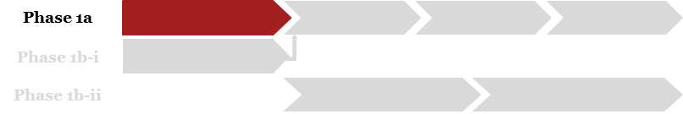
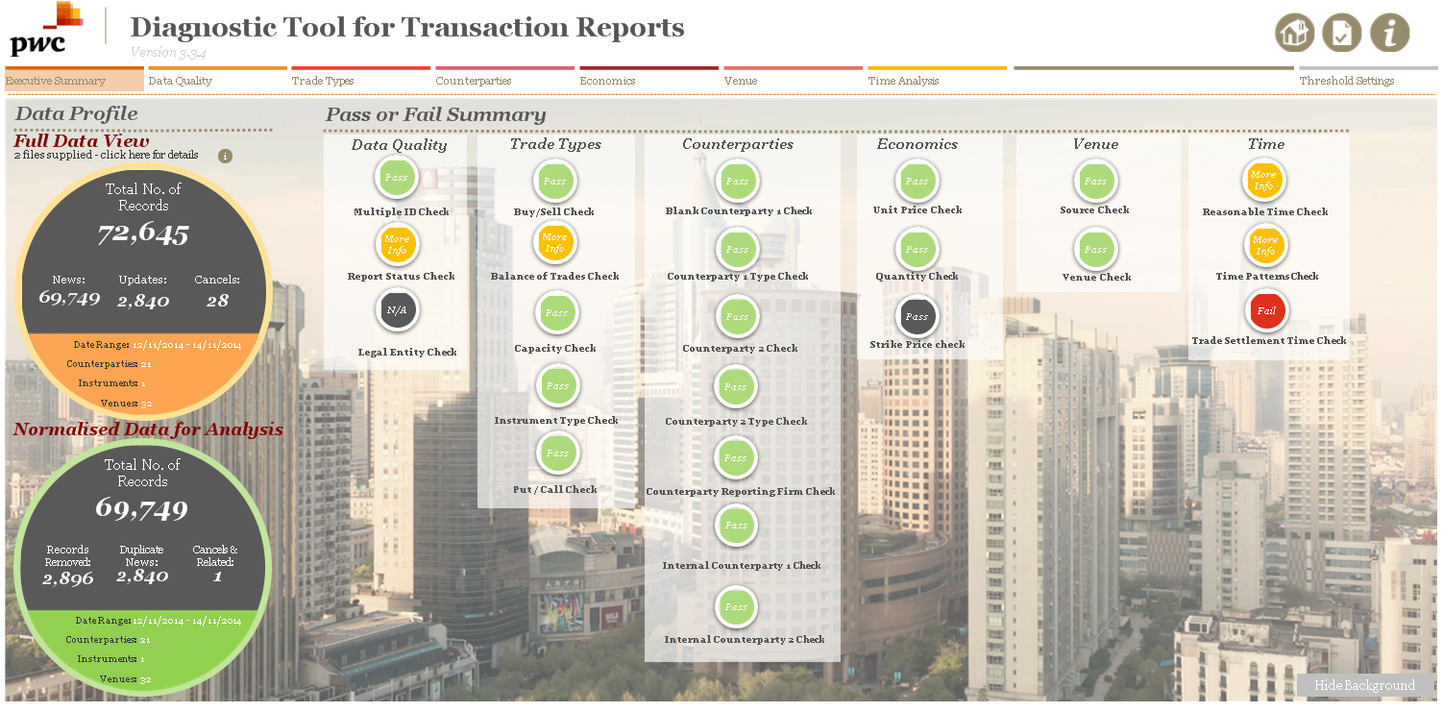
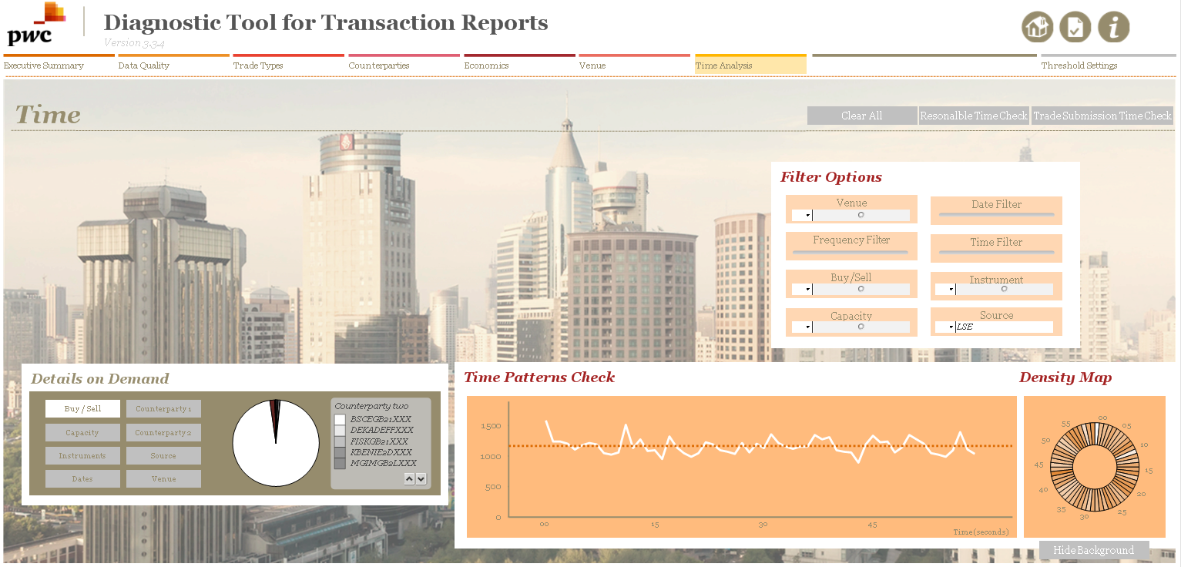
Scoping and Diagnostics Detailed approach
Identification of “high risk” issues in 6 weeks using our diagnostic accelerators.
The core objectives of the Scoping and Diagnostic work are the following :
Rapidly identify trade reporting errors using diagnostic tests which have been built up through our extensive experience of what others have got wrong in trade reporting. This work is prioritized due to your requirement to identify “high risk” issues as rapidly as possible. This is something for which our diagnostic tests have been specifically designed.
Understand and document your business and trade booking models. This work is prioritized since up-front understanding of these models is essential for the proper execution of our ‘one-day’ test conducted as part of Task 1 and will underpin the work we perform around your rule interpretation in Task 2.
Set-up and mobilization of the project.
The core activities of the Scoping and Diagnostic work are shown below.
The key outputs will be the following:
Documented understanding of your business models.
Documented understanding of your front-to-back trade flow.
Findings and observations raised as part of the diagnostic.
Initial recommendations for potential remediation action to be taken against findings raised.
Project
Set-up
Set-up project governance through the following:
Determining initial scope of business models and entities to be covered by the project.
Agreeing and document project governance processes and structures.
Establishing steering groups and any other governance structures required.
Business Models
Through review of documentation (trade mandates, remote booking policies ) document the business and trade models at a desk level with a focus on the following:
Nature and volume of trading activities undertaken and products traded.
Intragroup activity.
Entities that are subject to regulation based on activities undertaken.
Booking process with a focus on atypical bookings or risk management (e.g. Approximate Bookings).
Verify our understandings through interview with business stakeholders (typically desk heads or COO).
Diagnostic
Carry-out a series of diagnostic tests against your CFTC and EMIR trade and transaction reporting submiss0ns for reporting errors (see overleaf for more details).
Obtain relevant submissions for an agreed day across asset-classes.
Rapidly identify anomalies in these submissions which may indicate potential deficiencies in population identification, completeness, accuracy, or timeliness through our diagnostic accelerators.
Work through anomalies with your teams in Operations and Technology to surface issues.
With your teams, perform high-level root cause analysis to identify initial recommendations for potential remediation action.

Slide 11
Scoping and Diagnostics (cont’d) Detailed approach
Over the number of reviews of Transaction Reporting for EMIR and CFTC rules that PwC has conducted (as well as our experience on reviews of other regulations) we have developed and refined a diagnostic accelerator which can be run on actual submissions to identify significant volumes of errors. This allows us to significantly accelerate the identification of high risk issues and anticipate and prioritize areas of emphasis with respect to the ‘one day test’ work stream.
Diagnostic Accelerator – categories of questions and types of error typically identified
Is the price field populated for all trades?
Field Completeness and Formatting Checks
Are all required fields populated and are values correctly formatted?
Type of test
Key question
Examples
Types of error identified
Are any trades reported with a zero or negative notional?
Misreporting
Under-reporting
Over-reporting
Field Sanity Checks
Do the values of the fields make sense individually?
✓
Do all UTI listed for trade reporting have a corresponding valuation record?
Field Consistency Checks
Do the values of the fields make sense when considered together?
✓
Do we see intragroup transactions consistent with the business model explained to us?
✓
✓
Business Model Checks
Does the full population of trades reflect our understanding of your business models?
Are all trades reported by T+1 at the latest?
Timeliness of Reporting
Have all transactions been reported within the correct timeframe?
✓
✓
✓
✓
The focus of the diagnostic testing is largely on issues of misreporting. Issues with completeness of population are addressed as part of the 'one day test' work stream.

Slide 12
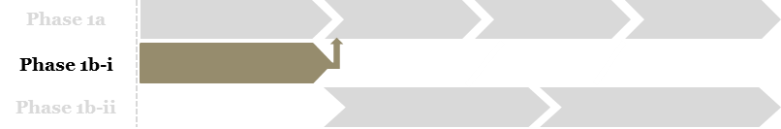
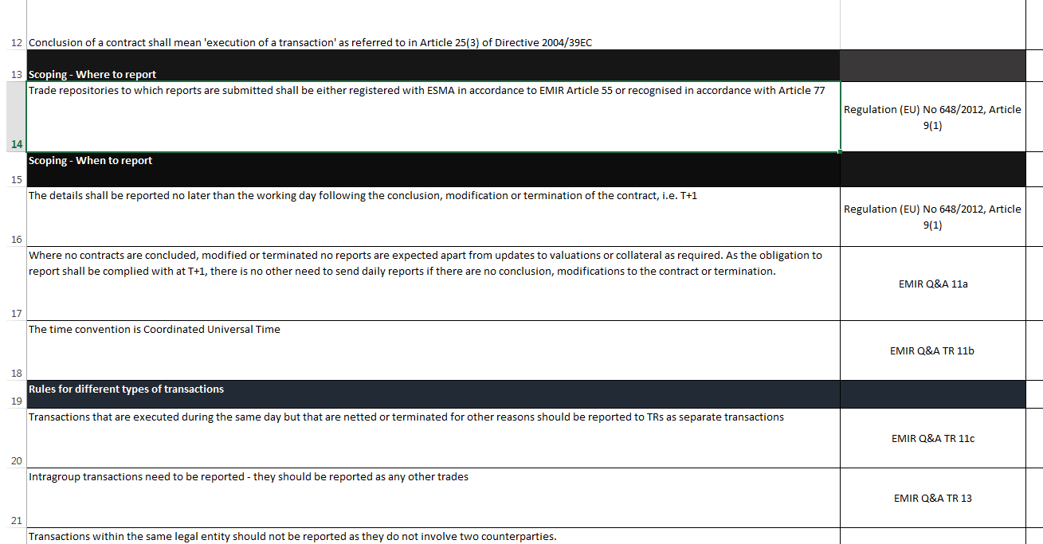
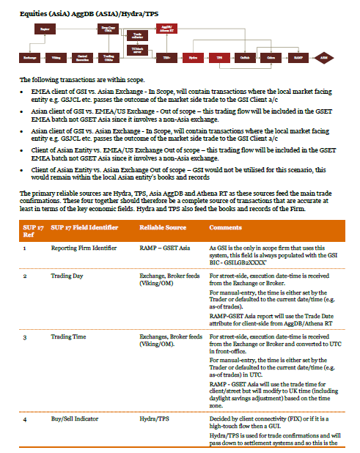
Initial Trade Reporting Rule Assessment Detailed approach
Identify issues with rule interpretation and sourcing in preparation for 'one day test'
The core objectives of the Initial Trade Reporting Rule Assessment work are the following:
Rapidly identify issues at a high-level with your current rule interpretations. This will include assessing completeness of the rule interpretation documentation and identifying issues through comparison with our understanding of the rules held in our accelerators.
Determine appropriate product types in scope under EMIR and CFTC trade and transaction reporting rules with reference to MS’s product taxonomy.
Determine whether interpretations and existing “reliable source statements” are fit for purpose to commence the 'one day test' and, if not, identify required actions to bring them up to standard (to be discussed as part of Checkpoint 1).
The core activities of the Initial Trade Reporting Rule Assessment are shown below.
Gap Analysis
Perform a gap analysis of rule interpretations versus our expectations through the following:
Determine the current population of existing rule interpretations for in scope trade reporting rules by working with your Operations, Legal and Compliance functions to source relevant documentation.
Where gaps are noted this will be documented in the repository. In instances where there is a complete absence of an available interpretation for an in scope regulation, this will be escalated immediately with next steps agreed.
The key outputs will be the following:
A repository detailing all available rule interpretations per in scope transaction reporting rule.
An agreed set of reliable sources for the purposes of conducting the one day test.
Specific findings and recommendations to address any observations noted.
Agreed next steps in order to commence the 'one day test' and identify interpretations that require a ‘deep dive’.
Challenging Interpretation
Challenge the existing rule interpretation through the following:
Perform an initial high level review of in-scope trade reporting rules by comparison with our rule interpretation accelerators and by assessing the current level of detail in rule interpretations versus our expectation.
Review and challenge current product scope within the rule interpretation.
Any limitations in the detail of the interpretation will be highlighted to management and next steps agreed upon.
Document the overall level of detail of rule interpretations and whether this, combined with rule interpretation gaps identified above allow us to commence the 'one day test'.
Reliable Source Assessment
Perform an initial assessment of “reliable sources” through the following:
Document and understand through walkthroughs the front-to-back trade flow covering the full trade lifecycle, from point of execution through various middle office processes and ultimately to a reporting submission.
Review existing sourcing documentation and use this (in combination with the above understanding) to form a view on appropriate systems to source data for the 'one day test‘.
Trade and transaction reporting review

Slide 13
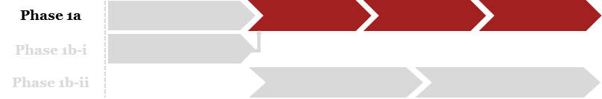
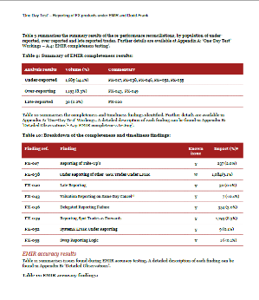
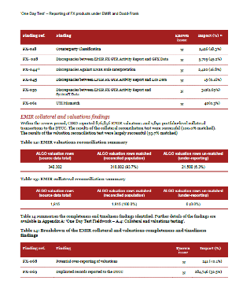
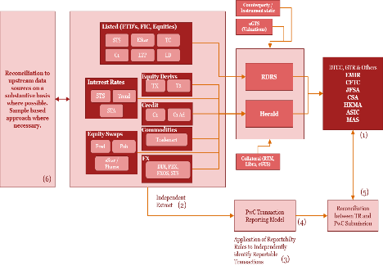
‘One day test’ Detailed approach
Assessing the completeness and accuracy of your current transaction reporting, across all asset classes and reporting regimes
The core objectives of the ‘One Day Test’ work are:
Identify issues relating to both the completeness (under and over-reporting) and accuracy (data field content) of your reporting.
Validate reliable sources via a series of reconciliations to upstream systems, including confirmations, exchange and broker feeds. In our experience, many of the significant findings we identify are related to aggregations and data quality issues occurring up stream of the systems that feed the Transaction Reporting platforms (Herald & RDRS).
Working with you, provide a root cause analysis and severity classification of the issues identified along with recommendations for remediation.
This phase will be conducted in tandem with the Deep Dive Rule Assessment and Traceability work. We expect there to be constant feedback between these streams with information from the ‘one day’ test informing traceability work and information on rule assessment and traceability informing insights from the ‘one day’ test.
The core activities of the One Day Test work are shown below.
The key outputs will be the following:
A detailed matrix of our findings and observations, supplemented with root cause analysis (conducted in conjunction with you) and a mapping to known issues where appropriate.
A quantification of the impact of each issue together with a severity rating (determined with you) in order to aid future remediation and planning.
Extract Validation
In order to perform the One Day Test, we require extracts of full transaction level event activity for the test period as well as EOD positions and valuations. We will independently request extracts from each agreed ‘reliable source’ and perform a series of validations to ensure the files are fit for purpose. We will:
Provide clear and detailed data requests for each source system, tailored to the specific asset class.
Meet with technology teams to clearly define the purpose and scope of the extract.
Reconcile source data against submissions in order to identify gaps in source extract.
Independent Re-Performance
Identify any instances of under, over and mis-reporting by comparing the PwC independent submission file to the actual submission for the same period:
Map the reliable source data to a PwC-developed data sourcing framework.
Cleanse, manipulate and enrich the source data with relevant static reference data (e.g. counterparty and instrument static).
Perform high-level data quality checks to validate filtering logic, data changes etc.
Independently apply reporting logic to determine which transactions are reportable and generate a transaction report for the relevant period.
Compare the regulatory submission data with the independently generated report to identify under/over reports and the accuracy of the content.
Upstream Recon
In order to get comfort over the validity of our chosen reliable sources, we will perform a series of reconciliations to upstream data sources (“systems of record”). This is typically a combination of sample testing and fully substantive reconciliations. For exchange traded products we will seek to reconcile to direct exchange feeds or broker confirms. For OTCs we will identify the immutable source in order to validate the reliable sources.

Slide 14

‘One day test’ (cont’d) Detailed approach
PwC methodology |  | Our understanding* of your systems, aligned to our testing methodology steps
1 | Obtain a data extract of your submissions (for each regime). This will include the period of testing and 3-4 subsequent days in order to validate late reporting and trade life-cycle events.
2 | Independently obtain an extract from each trade store which is determined to be in scope to validate that all trades are being considered for reportability. (Currently understood to be 20 sources). Run our existing suite of validation tests to ensure the extracts contain a full population of transaction level events on the day.
3 | Map the trade store data to a PwC-developed reportability matrix.
4 | Load, transform, enrich, cleanse, aggregate and filter the ‘raw’ data from reliable source systems (including external sources where applicable). Independently apply reporting logic to determine which transactions are reportable and generate a transaction report for the relevant period.
5 | Compare the submission data with the independently generated report to identify under/over reports and the accuracy of the content. All discrepancies will be validated with MS SME’s, we will document root cause, map to known issues logs and classify for severity.
6 | Perform upstream reconciliations in order to validate the completeness and accuracy of ‘trusted sources’. This will be particularly relevant for Equities where testing the reliability of ‘Fred’ will be an area of focus, as we are aware of the significant up-stream transformations.
* Given the significant volume of trade activity in the bank, validating the full transaction population for one ‘ordinary’ business day typically provides coverage over the majority of trade / reporting scenarios. Where we believe the volumes or complexity of an asset class challenge this assumption, we will extend the scope to validate multiple days of submissions. It is crucial that we test the full population (100%) of trades for any given period, as this is the only way to effectively identify issues relating to completeness (Under and Over reporting). Using other sampling methods (e.g. 10% of trades in a given population) will offer validation of accuracy of submissions but not completeness.
* Subject to verification as part of the programme

Slide 15
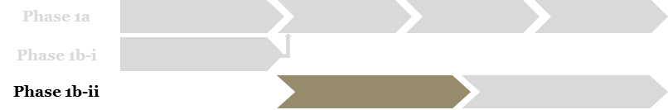
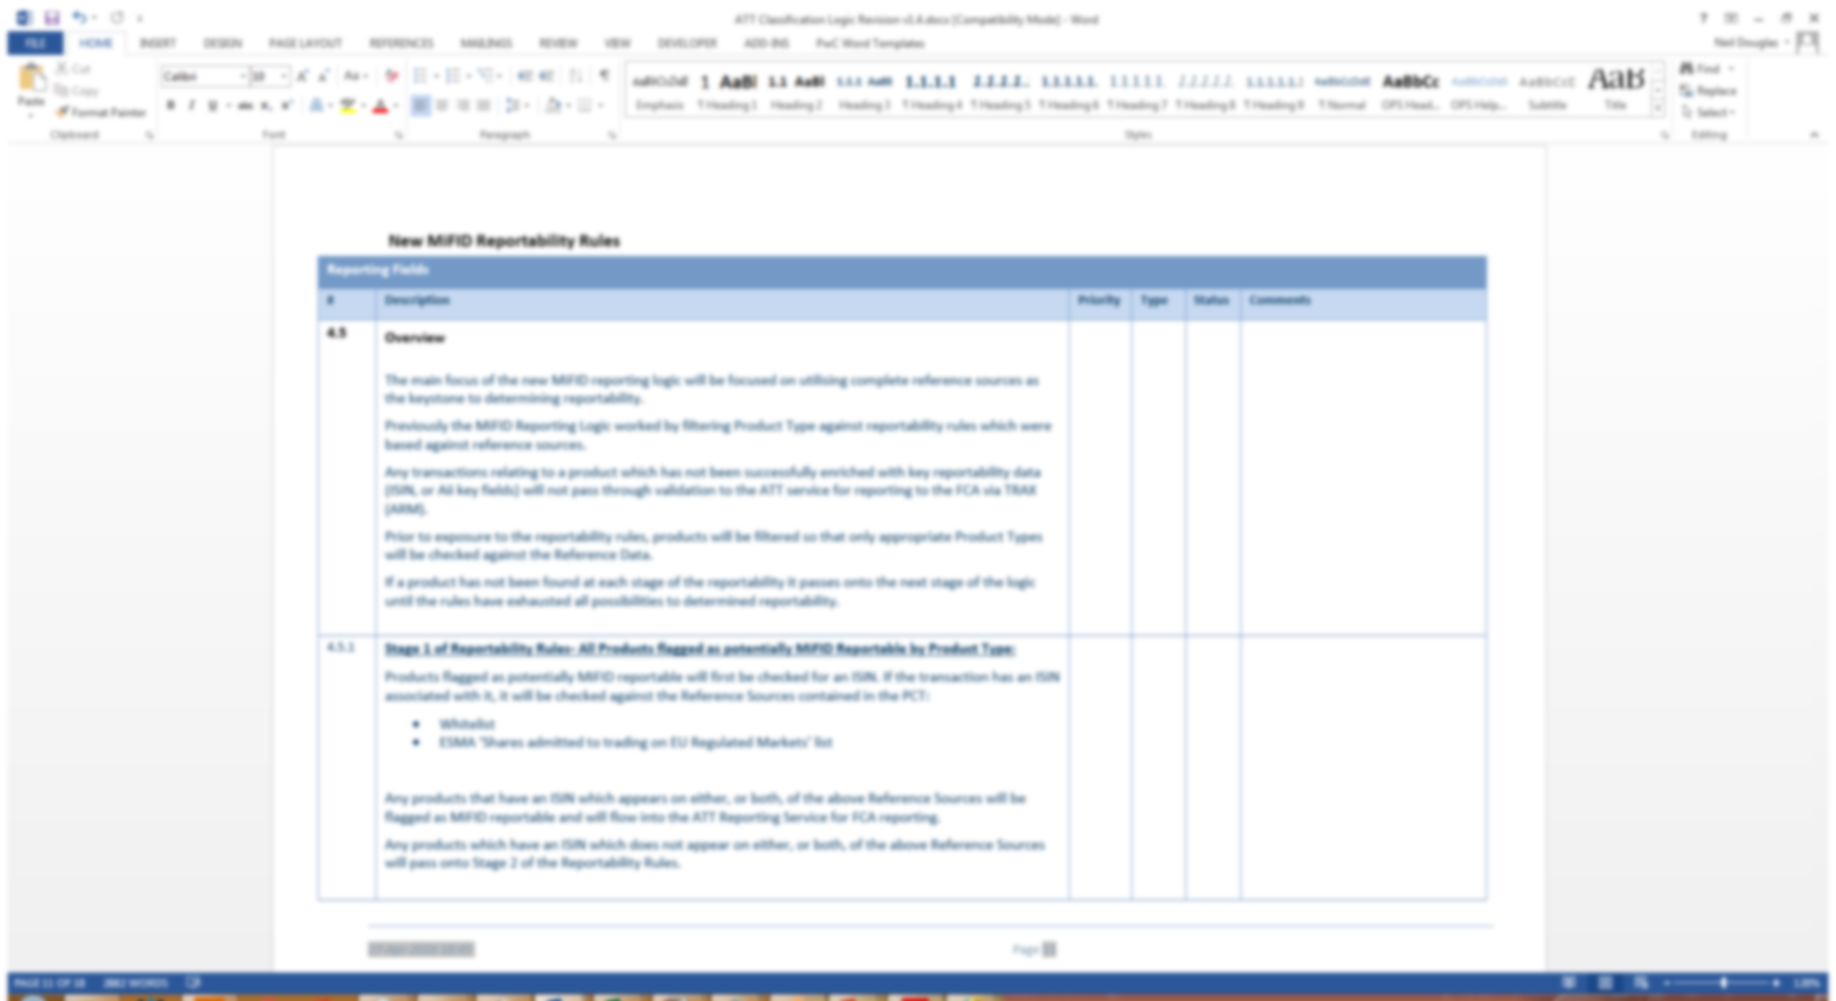
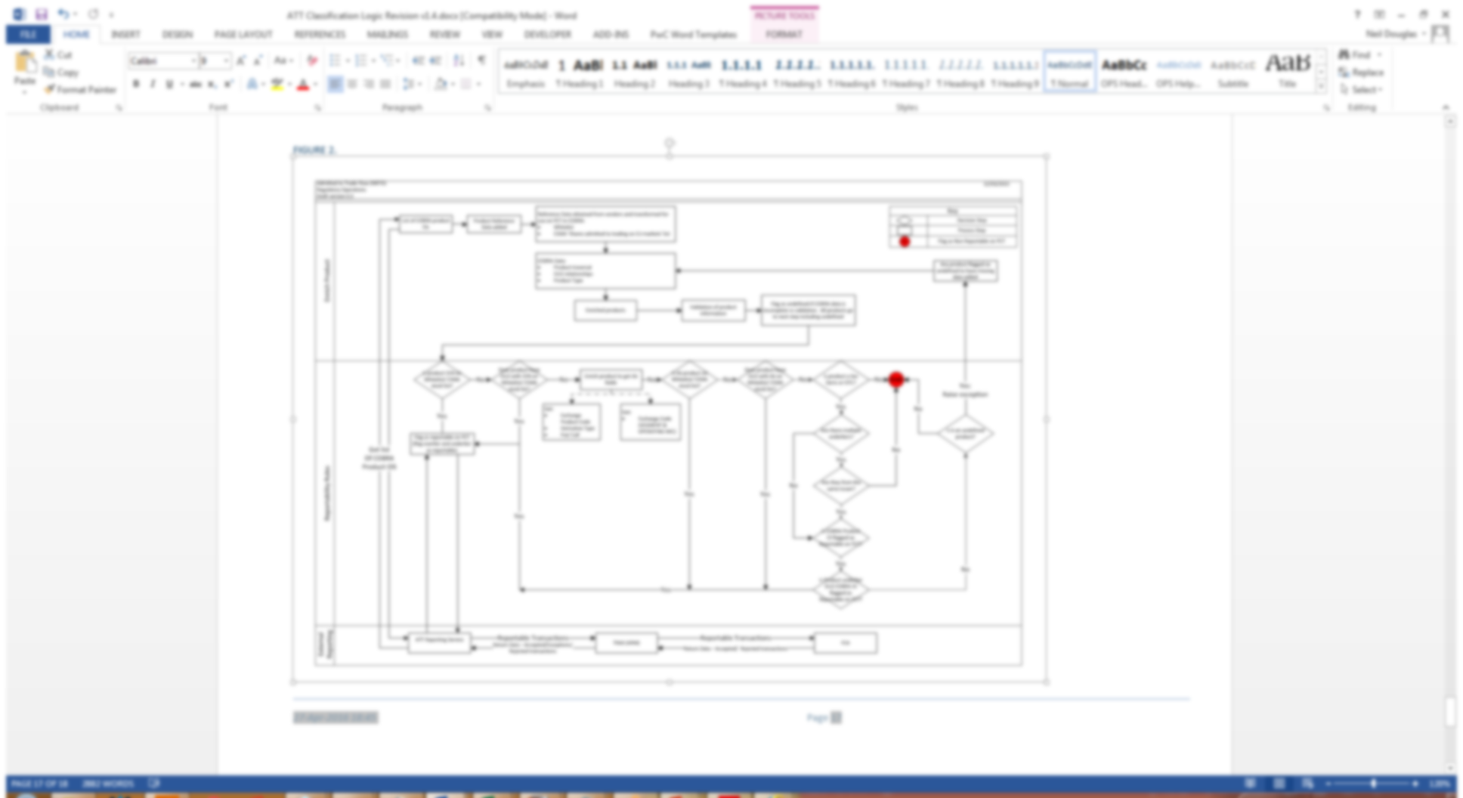
Deep Dive Trade Reporting Rule Assessment and Traceability Detailed approach
Challenging the accuracy of rule interpretation and mapping the traceability of reportable attributes through the trade flow
The core objectives of the Deep Dive Trade Reporting Rule Assessment work are the following:
Challenge the accuracy and detail of rule interpretation documentation on a field-by-field basis based on our understanding of the rules. This will be accelerated through leveraging our own existing detailed interpretations.
Raise findings where limitations exist and agree on required actions with key MS stakeholders.
Create a traceability matrix detailing how each reportable attribute (i.e. information that is required per field) is created at source and processed through the front-to-back trade flow.
Design an auditable process for the ongoing maintenance of rule interpretation and attribute traceability matrix.
The core activities of the Deep Dive Trade Reporting Rule Assessment are shown below.
Rule interpretation deep dive
We will undertake a deep dive on your rule interpretation documentation and review and challenge current interpretations on a field-by-field basis.
We will leverage the understanding gained of your business model and trade flows during the scoping work to determine if interpretations contain the required level of MS specificity.
We will also leverage our knowledge of available regulator and industry body guidance to determine whether fields have been interpreted correctly.
We will document our observations and recommendations and report these to management.
The key outputs will be the following:
Observations and accompanying recommendations that will enhance your current rule interpretation documentation.
A matrix detailing attribute traceability per asset class, per reporting obligation.
Recommendations on an enhanced process around rule interpretation and attribute traceability that allows for a full audit history.
Traceability matrix
As required rule interpretation enhancements are understood and actioned, we will work in parallel to produce a matrix of reportable attributes per asset class, per reporting obligation.
We will leverage knowledge gained during trade flow walkthroughs and during the 'one day test' to map out how each reportable attributed is created and processed through the front-to-back trade flow, i.e. from reliable source through to reporting submission.
We will document this in a traceability matrix that can be maintained on a go-forward basis.
Auditable process
We will assess your current processes around rule interpretation and attribute traceability and limitations will be raised as findings or observations.
We will make recommendations on how the process can be enhanced, either through greater discipline around a manual process or through the use of automated workflow solutions.
In our experience, such solutions are capable of capturing document version changes, cross-referencing against prior versions and providing an audit log of who made changes and signed off.

Slide 16
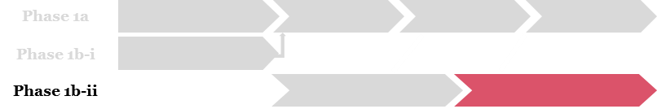
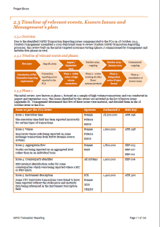
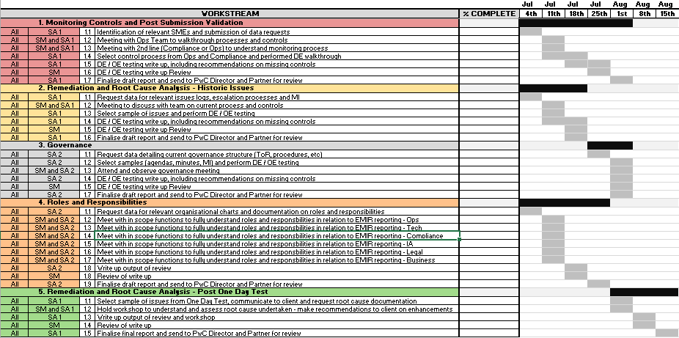
Controls and Governance Review Detailed approach
Assessing your control and governance framework versus our benchmark framework.
The core objectives of the Controls and Governance Review are the following :
Create a benchmark trade reporting control framework leveraging our experience from conducting reviews over a large number of peer firms.
Identify gaps and issues with your current control and governance framework against this benchmark framework.
Assess the completeness of current UAT test libraries.
Given our knowledge of your environment and framework gained through this work, and the work conducted in other tasks identify further opportunities for accelerating your plan for enhancing the control framework.
The core activities of the Controls and Governance Review are shown below.
Benchmark framework
Based on our extensive prior experience we will set out a benchmark framework that covers the following areas:
Monitoring controls – Pre and post-submission validation checks.
Accuracy and completeness reconciliations.
Change Management procedures (including upstream change management and UAT processes).
Issue management – Root cause analysis and remediation.
Roles and responsibilities – Across all lines of defence (Ops and Tech, Compliance and Internal Audit).
Governance and oversight – Committee structures, MI, senior management accountability.
The key outputs will be the following:
An agreed benchmark control framework.
Documented current state assessment of the control environment as it stands.
A gap analysis showing the delta between current arrangements and our proposed framework (including potential gaps in your UAT framework).
A report summarising our approach, along with findings and detailed recommendations.
Current state assessment
Undertake a current state assessment of your framework and identify gaps and recommendations through the following:
Desktop review of your existing framework and identification of control gaps through comparison of your controls with the controls in the benchmark framework.
High-level completeness review of UAT testing suite through comparison with our understanding of business models and rule interpretation.
Design effectiveness testing through control walkthroughs of a pre-agreed sample of processes and controls to identify areas where the control design is flawed or does not meet the standards of the benchmark model.
”
Future State
Review your current plan and identify opportunities for acceleration through walkthrough and challenge of current plans and comparisons to our benchmark framework and any recommendations arising from the current state assessment.

Slide 17
Our team and fees For phases 1a and 1b

Slide 18
Global engagement model for phase 1a and 1b Engagement team structure
The coordination of the engagement will be led out of London and over the course of the engagement we can flex the team location as appropriate
The high-level team structure and key individuals in the engagement team are as shown. Bios for key individuals shown here are included in the appendix.
Frank Badalamenti
US Engagement Leader
Nick Bouch
Engagement Partner
Grace Vogel
SME Council
London based
New York based
Location TBC
Nathan Chao
US Trade Support
Neil Douglas
Engagement Director
US PMO
UK PMO
Task 1
Task 2 and 3
Mike Newton
Data lead
Joe Gennings
Regulatory and Control Lead
Owen Jones
‘One-day’ test lead
‘One day test' PMO
Mark Salmen
Controls and governance lead
Trade reporting data analyst
Trade reporting data analyst
Regulatory and control analyst
Regulatory and control analyst
Regulatory SME - EMIR
Trade reporting data analyst
Trade reporting data analyst
Regulatory and control analyst
Regulatory and control analyst
Regulatory SME - CFTC
Trade reporting data analyst
Trade reporting data analyst
Data lineage analyst
Data lineage analyst

Slide 19
Global engagement model for phase 1a and 1b Proposed governance structure
It is important that appropriate governance and oversight is maintained by both MS and PwC.
A proposed governance structure is included but we will interplay in to any MS preferred governance structure.
Proposed example Governance and Oversight Model .
PwC SME Advisory Council
Monthly TR Global SteerCo
Joint MS/PwC
PwC New York led
Weekly TR PMO working group
Data work stream
Rule Assessment work stream
Control and Governance work stream
Governance & Oversight Responsibilities
Global SteerCo – responsible for overall strategy, direction and status across all in-scope territories. Requires aggregated reporting updates and undertakes approval of key decisions relating to progress, investment and regulatory interaction.
PwC SME Advisory Council – our group of SMEs will be led by Grace Vogel. This group will provide senior regulatory support to your SteerCo in order to ensure peer insights are made available globally. Further this group will provide an independent challenge to the MS findings from the project.
TR PMO Working Group – responsible for weekly status reporting and preparation of monthly steerco information. Can implement decisions and re-direct resources according to programme plan status. Brings cross work stream dependencies together and enables discussion and decision recommendations for SteerCo.
Work stream leads – responsible for day-to-day delivery of their work streams in order to achieve programme deliverables.

Slide 20
Fees Investing in our relationship
As we progress through the engagement we will endeavour to reduce the overall costs by leveraging our off-shore capability; specifically around the data testing
We will obtain MS’ approval to move activity offshore in accordance with pre-agreed criteria that meets your internal approvals
The estimated Time and Materials fees for delivery of phases 1a and 1b (across all three tasks) and based on the agreed PwC and MS rate card is £3,330,000. However based on our existing relationship with you we are prepared to invest an additional 10% of our fees. Total investment is £333,000 with estimated fees¹ for phases 1a and 1b £2,997,000.
We would of course welcome the chance to discuss the assumptions overleaf that we have used to come up with the proposed fee structure over the next 48 hours in order to ensure our cost proposal and approach meets the needs of management.
Phase 1a | £
Oversight and management | 170,000
Scoping – Business models and data extracts (Task 1) | 90,000
Diagnostic – CFTC and EMIR (Task 1) | 310,000
‘One day test' – CFTC and EMIR (Task 1) | 1,650,000
Sub total phase 1a | 2,220,000
10% investment | 222,000
Total T&M cost to complete phase 1a | 1,998,000
Phase 1b | £
Oversight and management | Included in Phase 1a
Phase 1b-i – Initial trade reporting rule assessment (Task 2)² | 240,000
Phase 1b-ii – Deep-dive trade reporting rule assessment (Task 2) | 485,000
Phase 1b-ii – Control and governance review (Task 3) | 385,000
Sub total phase 1b | 1,110,000
10% investment | 111,000
Total T&M cost to complete phase 1b | 999,000
Total investment | 333,000
Total T&M costs for phases 1a and 1b | 2,997,000
Although we understand at this stage phase 1c and 1d still require confirmation of which regulations are in scope the expected duration would be approximately 12 months and the cost would be based on the ongoing delivery model and where we are able to deploy more work off-shore. We will work with you throughout Phases 1a and 1b to refine our approach as we gain a detailed understanding of your architecture and systems and provide a proposed onshore/offshore costing model.
Notes:
¹ This estimate excludes out of pocket expenses, VAT and all other applicable taxes. We will proactively work to manage the costs in line with MS budgets
² To complete Phase 1a the initial trade reporting rule assessment needs to be completed although for transparency this is costed as phase 1b

Slide 21
Key Assumptions
Our approach and fees are based on a number of key assumptions. We would however welcome the discussion with MS to review and challenge these assumptions and understand where there maybe scope and cost savings.
PwC requires a robust data analytics environment to conduct this assessment. PwC already has such environments available internally but our current assumption is that MS would like to keep the data in-house. PwC would then require MS to arrange:
Standard desktop computer and/or remote access to the MS environment for the team in multiple locations (London and NY).
Relational database (Oracle, SQL Server) or similar analysis environment with appropriate memory, disk space, appropriate access levels, and licensing.
The work will require significant resource commitments from MS. In particular we will require the following to allow timely response to our queries (within 4-8 hours) and data requests (with 24 hours).
An overall MS PMO to co-ordinate managing our contact with and requests from MS.
An “asset class” point person to act as our primary contact for expertise on the data sources and co-ordinate contact with technology on each asset class.
IT/Data Owners for each system in scope who can understand the system and the data who can provide detail on data fields, logic and access to extract scripts and reports.
Operations Contacts for each product type with knowledge of products, filtering and transformation, selection criteria, data lineage and the EMIR reporting requirements.
Our initial walkthrough with your Technology team has identified around 20 source systems with a larger number of upstream systems. We are assuming that the regulatory reporting infrastructure is largely in line with these projections (and with the high level system map including in our proposal). However, if the number of systems can be reduced this will have an impact on the overall scope and also potentially the fees.
MS are able to source complete and accurate data from internal source systems in a reasonable timeframe, typically no more than 2 weeks from the point of requests to being able to validate we have a complete and accurate raw file.
MS will be responsible for initial severity assessment, trades impacted and root cause analysis for issues identified by us.
Where the RFP states “Validate” we have assumed that MS have already developed the required artefact and that our task will be to provide recommendations. In cases where the required artefact is not of an appropriate standard to do this, we will escalate this to you.
In particular, our costings assume that the MS rule interpretations and existing reliable source statements are sufficient to conduct the one day test. We will determine whether this is the case by Checkpoint 1 and make appropriate recommendations if not.
The scope of the work is assumed to apply to the 1st Line of Defence only. We will only consider Compliance and Internal Audit in regards to their role in governance under “Roles and Responsibilities”.
The review of UAT testing is restricted to understanding the effectiveness of your current UAT process and framework as well as sample testing of your UAT test library.
The challenge of your project does not include a full project governance review but extends only to looking at and providing independent challenge to current project plans.

Slide 22
Appendix 1 – Team bios

Slide 23

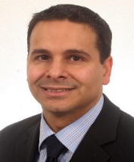
Your MS lead partners
Nick Bouch
Partner
Global and UK Engagement Leader
T: +44 (0)7703 563564
E: nick.bouch@uk.pwc.com
Frank Badalamenti Principal
US Engagement Leader
T: (646) 471 1460 E: frank.badalamenti@pwc.com
Nick is the leader of PwC’s UK Financial Services Advanced Risk and Compliance Analytics (ARCA) team as well as the UK Financial Services Data & Analytics Leader. In this role he has overseen the development of PwC data analytic solutions delivered in support of transaction reporting assurance. As part of this oversight, Nick has experience in leading Transaction Reporting Assurance engagements including both data analytic and governance-focused work across a range of obligations.
Engagement leader for EMIR transaction reporting assurance for a large US based global universal bank.
Engagement leader for Dodd-Frank and EMIR trade reporting assurance for a UK based global bank.
Engagement leader for MiFID and EMIR transaction and trade reporting assurance for a UK based private bank.
Nick was the engagement leader for developing and implementing a cross-regulatory data management strategy and control framework for a leading global bank
Delivery lead for a conduct risk compliance framework and dashboard for the Conduct Risk Committee and ExCo for a global investment management firm as required by the FCA.
As a Partner in PwC’s US Forensic Services practice, Frank assists clients with the assessment and remediation of operational, compliance, and technology-related risks, and in the development of an effective compliance and internal control environment. He specialises in advising clients on matters related to financial crimes, specifically fraud, money laundering, bribery and corruption, and securities trading schemes, as well as matters related to operational failures in the areas of regulatory trade reporting, trade execution and allocation, billing of client fees and commissions, and recordkeeping. Over his career at PwC, Frank has assisted MS on over 15 data-intensive remediation matters across these areas.
He has deep industry knowledge gained from over 17 years advising the firm’s clients and his first-hand experience garnered from having worked on the other side of the desk as deputy chief auditor of a foreign financial institution with operations in North America and Latin America.
Over the past four years, Frank has served as the engagement leader on regulatory trade reporting assessments for 8 different global financial services clients, providing both data analytic and governance-focused work across a range of obligations including Large Options Position Reporting (LOPR), Electronic Blue Sheets (EBS), Large Trader, Short Interest Reporting, and CFTC Trade Reporting, and has presented findings from his work to FINRA via in-person meetings on three separate occasions.

Slide 24

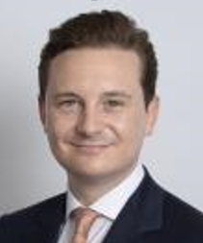
Your MS UK team
Neil Douglas
Director
T: +44 (0)7889 643945
E: neil.m.douglas@uk.pwc.com
Joe Gennings
Director
T: +44 (0)7764 958070
E: joe.gennings@uk.pwc.com
Neil is a Director within PwC’s Financial Services Risk and Regulatory practice in London. He has 12 years of experience working with and within Investment Banking across a variety of functions (Risk, Finance and Front Office) which has allowed him to build up detailed front to back knowledge of Investment Bank processes and controls across the range of asset classes.
Neil leads our Transaction Reporting assurance proposition. As such, he leads projects which combine controls and data expertise to assist firms in meeting their Transaction Reporting obligations. This has covered a range of trade and transaction reporting regulatory obligations.
Recent engagements include:
Engagement Director taking day-to-day lead over a Skilled Person Review for MiFID Transaction Reporting at a large US investment bank. This review covered governance, controls as well as providing comfort over completeness and accuracy through data analytics work.
Engagement Director for a deep-dive review of EMIR transaction reporting at a large US based global universal bank. This review covered data assurance work as well as review of governance and controls.
Joe is a Director in PwC’s Financial Services Risk and Regulation practice. He brings over 10 years of Compliance, Operational Risk and Internal Audit experience from his time at Goldman Sachs and Citi.
In these roles, Joe was the Compliance Officer responsible for oversight of all of Goldman Sachs International’s non-financial regulatory reporting obligations. This included FCA Transaction Reporting, EMIR, CFTC Parts 43 and 45, position reporting (Major Shareholder, ESMA Short, etc) and Takeover Panel disclosures. Joe has deep, first hand experience of the roles of all three lines of defence in this space
Joe brings his extensive industry experience to bear in leading the regulatory, governance and control elements of our Transaction Reporting engagements. Recent engagements include.
Leading the control and governance element of a deep-dive EMIR reporting review at a large US based global universal bank. This review required working with stakeholder across all three lines of defence.
Providing expert regulatory insight and support to multiple reviews, including multiple Transaction Reporting assurance reviews of Dodd-Frank and EMIR.

Slide 25
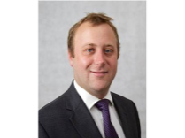

Your MS UK team (cont’d)
Mike Newton
Director
T: +44 (0)7715 034841
E: michael.newton@uk.pwc.com
Owen Jones
Senior Manager
T: +44 (0)7808 106805
E: owen.jones@uk.pwc.com
Mike is a director in PwC’s UK FS ARCA practice. Michael is a data specialist who works with clients across both retail and investment banking to solve regulatory data issues, including regulatory regimes with transaction reporting requirements.
Mike has led large scale transaction reporting engagements for a large global bank for MiFID, EMIR and Dodd-Frank reporting regimes.
He has also led transaction reporting engagements for a leading UK private bank under MiFID and EMIT reporting regimes.
Mike also leads PwC transaction reporting managed services offering, covering MiFID, EMIR and Dodd-Frank.
Owen has over 9 years experience helping banks tackle complex issues relating to risk, regulation and compliance. Owen comes from a strong technical background in software development, fraud analysis, data analytics, ETL, predictive modelling and data management. He now combines these skills with project and client management to lead teams to deliver a myriad of engagements in a efficient and timely manner.
For the past 4 years, Owen has specialised in the world of transaction reporting, helping clients to navigate the complex world of MiFID, EMIR and Dodd-Frank reporting obligations. Owen pairs his technical expertise with detailed knowledge of the regulations and how they should be applied to daily operations.
Lead MiFID Transaction Reporting review / assurance engagements for 4 global banks. Managing the data work stream to independently create a regulatory report as a proxy for identifying issues with completeness and accuracy of submissions.
Built out the MiFID Assurance approach to review EMIR and Dodd-Frank reporting obligations for 3 global banks. Owen has also developed an automated managed service solution to validate transaction reporting on an ongoing basis.

Slide 26

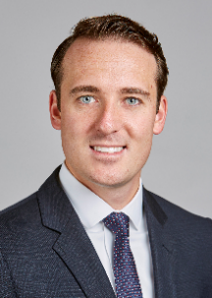
Your MS US team
Nathan Chao Director
T: (646) 471 4905 E: nathan.l.chao@pwc.com
Owen Bacewicz Manager
T: (860) 966 0447 E: owen.bacewicz@pwc.com
As a Director in PwC's Forensic Technology Solutions practice in New York, focused on the financial services industry, Nathan has over 13 years of experience leading technology, fraud, compliance, audit, and regulatory risk assessments of client's organisations.
Combining his understanding of technology, data, processes, and key fraud risks, he assists clients and outside counsels design responses which leverage technology and data analytics to solve issues relating to investor suitability, Bank Secrecy Act (BSA), Anti-Money Laundering (AML), broker compliance, trade monitoring, bank fraud, financial reporting, and the Foreign Corrupt Practices Act (FCPA).
He has significant experience in responding to and interacting with regulatory agencies including the Federal Reserve Board (FRB), Federal Depositor (FDIC), Office of the Currency of the Comptroller (OCC), and other SROs including FINRA (formerly NASD).
Owen specialises in advising global financial institutions on complex organisational, operational, compliance, and risk management challenges as the result of regulatory change and scrutiny.
His international experience in Hong Kong and London includes assessing the impact of US (Dodd-Frank), Canada, EU (EMIR), Hong Kong, Australia, Singapore, and Japan OTC derivatives regulations on banks and developing strategic plans to address regulatory requirements on a global scale. Owen has extensive experience in project management and leading global teams to bring PwC’s global expertise to the table.
His experience in the derivatives market includes conducting regulatory impact assessments of reporting regulations (e.g., CFTC, ASIC, CSA/Provincial Regulators in Canada), comparative analyses between global reporting regimes, as well as drafting implementation project plans to assist clients in addressing new reporting requirements.

Slide 27


Your MS SME Advisory Council
Grace Vogel Managing Director
T: (347 )533 0788 E: grace.vogel@pwc.com
Jason Gaswirth
Principal
T: (646) 471 2586 E: jason.gaswirth@pwc.com
Grace joined PwC’s Banking and Capital Markets practice as a Managing Director in June 2014. Previously, she was an Executive Vice President, member regulation at Financial Industry Regulatory Authority where she managed the Department of Risk Oversight and Operational Regulation with responsibility for the ongoing surveillance and annual examinations of largest member firms for financial and operational compliance and areas of broker-dealer risk management and supervision.
She also chaired the Intermarket Financial Surveillance Group from 2004 to 2013. Prior to FINRA, Grace was an executive Vice President at the New York Stock Exchange, a Deputy Controller at Citigroup, and a Chief Accounting Officer at JP Morgan & Co.
Jason is a Principal within PwC ‘s Capital Markets Strategy, Technology and Operations practice. He has extensive experience bridging business and technology in strategy development, program and project management, and business and functional analysis for leading capital markets clients.
Jason has also led business and technology driven change initiatives around organisational design, books and records transformation, IT portfolio management, and risk management for capital markets and banking firms. Since 2008, Jason has led numerous large change initiatives for MS.
Prior to MS, Jason owned a portfolio of risk management and change initiatives at a competitor/peer institution.

Slide 28


Your MS SME Advisory Council (cont’d)
Ann Gonzalez
Principal
T: (646) 471 8371 E: ann.p.gonzalez@pwc.com
Margaret Paulsen Managing Director
T: (703 )918 3027 E: Margaret.paulsen@pwc.com
Since joining PwC, Ann has assisted multiple global banks through their compliance responses to US and European Regulatory Reform. To help firms comply with the Dodd Frank Act, EMIR and MiFID mandates, Ann has helped firms design and implement new Global Operations and Compliance Target Operating Models - from building new global governance models to standardizing Policies and Procedures across legal entities and subsidiaries to building new reporting functionality. she has also assisted firms analyze and manage the business impacts of Regulatory Reform on their businesses.
The eight years prior to joining PwC, Ann worked at the DTCC and subsequently at its joint business venture with Markit, MarkitSERV, where she ran the Reporting Division. At DTCC, she helped build and launch DerivSERV, the Credit Default Swaps trade confirmation platform, the Trade Information Warehouse (prelude to the regional Swaps Data Repositories and the Global Trade Repository) and she managed the implementation teams through the Industry’s CDS Central Settlement initiative. Ann also ran regional forums on back office operational efficiencies and the importance of a global trade repository. In addition, she worked with market makers and end users to understand and improve their OTC derivatives middle and back office operations to meet mandated trade submission and timeliness targets as well as industry reporting initiatives.
Margaret is a financial services regulatory specialist. With over 20 years of experience as a former bank regulator and financial services attorney, Margaret supports diversified financial institutions and technology firms with their expansion strategies, regulatory driven operational changes, and regulatory mandates from enforcement actions. She is conversant in the full range of federal banking requirements (Dodd-Frank, BHC Act, International Banking Act, National Banking Act).and supports firms seeking to enter or address issues associated with regulated banking activities
Margaret also works extensively on global derivatives regulation. She advises clients on swap dealer registration and how to operate in regulated derivatives markets. She has led the design of several front-to-back swap dealer compliance programs, including manuals, policies, procedures, monitoring tools and CCO reporting. She has also advised other market participants on how to manage change in derivatives market practices.
Margaret joined PwC in 2010 after working as a bank regulator at the Board of Governors of the Federal Reserve System and a financial services attorney in private practice in New York and Washington, D.C., She is a frequent speaker and author on industry reform and other professional matters and serves as Chair of the Securities, Derivatives and Capital Markets Subcommittee, American Bar Association Banking Law Committee.

Slide 29
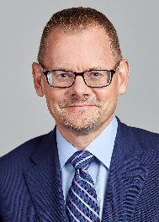
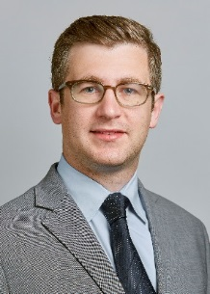
Your MS SME Advisory Council (cont’d)
William Penner
Director
T: (202) 4262 9326 E: william.penner@us.pwc.com
Samuel Crystal Director
T: (646) 471 2520 E: samuel.crystal@pwc.com
William joined PwC’s Financial Services Regulatory practice in 2011 after 12 years with the U.S. Commodity Futures Trading Commission (“CFTC”). He served in a number of roles at the CFTC including Counsel to two commissioners and Deputy Director of the Compliance and Registration section within the Division of Clearing and Intermediary Oversight.
Prior to the CFTC, William spent four years as a litigator with a San Francisco law firm. Since joining PwC, he has advised clients on various aspects of compliance with the Dodd-Frank Wall Street Reform and Consumer Protection Act. In particular, he has assisted firms, both domestic and international, with issues associated with Title VII swap regulations.
Sam has worked within the Banking and Capital Markets sector for over 10 years, having joined PwC in 2009 with a wide range of experience in the specialising in the review of business functions and processes.
He has addressed a variety of business issues and provided change recommendations, from the construction of business cases through to design and implementation of cross-functional processes and large core-banking systems, working closely with both C-level executives as well as implementation leaders.
He has extensive knowledge of the Dodd-Frank Title VII derivatives regulatory landscape, working for a number of years on analysis of the impact of rulemakings, through to the practical implementation of changes to the business.
He has developed a deep understanding of the regulations, the industry response, and the practical technical and operational impacts for global banking institutions, with a primary focus on Trade Reporting. He has led the PwC knowledge sharing initiative across the many client engagements.
His prior experience also includes the end-to-end review, design and implementation of cross-functional business processes within a number of investment banking functions and for the implementation of large core-banking systems.

Slide 30
Additional global regulatory contacts
Canada
Jason Boggs (Partner)
Jason.boggs@ca.pwc.com
Rajesh Urathu (MD)
Rajesh.urathu@ca.pwc.com
China & Taiwan
Kevin Li (Director)
Kevin.kl.li@cn.pwc.com
Lawrence Ong (Director)
Lawrence.s.ong@tw.pwc.com
Israel
Nir Zepkowitz (Partner)
nir.zepkowitz@il.pwc.com
Hong Kong
Philip Straley (Partner)
Phillip.straley@hk.pwc.com
Kishore Ramakrishnan (Director)
Kishore.Ramakrishnan@hk.pwc.com
Singapore
Peter Tan (Director)
Peter.bt.tan@sg.pwc.com
Japan
Greg Profeta (Partner)
gregory.g.profeta@jp.pwc.com
Brent Berg (Senior Associate)
Brent.berg@jp.pwc.com
Clarence Paul (Director)
Clarence.c.paul@jp.pwc.com
Australia
Mahindroo Yura (Partner)
Yura.mahindroo@au.pwc.com
Giancarlo Bonato (Director)
Giancarlo.bonito@pwc.com

Slide 31
Appendix 2 – Relevant experience

Slide 32
Representative experience
Client type: US universal bank
Client type: European securities broker
Engagement scope
Our client had identified EMIR reporting issues impacting multiple asset classes. We independently recreated a reporting submission for a given day spanning all asset classes and reconciled this versus content at the TR in order to identify anomalies. We also performed a detailed management review of governance and control arrangements. The end product was a detailed report outlining issues uncovered and recommendations for moving forward.
Engagement scope
Following two self identified issues with MiFID transaction reporting, the UK subsidiary received a letter from the FCA asking them to attest to having understood their obligations and put in place controls to ensure that they were completely and accurately reporting.
PwC approach
PwC worked with management to:
Conduct an extensive review of processes, controls and governance;
Review scenario and trade flow documentation;
Perform an independent reconciliation of one day’s trades between their source systems and the transactions reported to the FCA; and
Outline recommendations on how systems and controls could be suitably enhanced.
Engagement outcomes
Our unique experience of undertaking work of this scale and complexity in relation to EMIR allowed the client to understand the full breadth of potential issues they faced. We worked with them to outline appropriate recommendations – both in terms of system flows, controls and enhanced governance and oversight arrangements.
PwC approach
PwC was asked to carry out on behalf of internal audit a detailed review of MiFID transaction reporting. Our review identified further transaction reporting issues and recommended remedial action to address them. Our output was used by management as the comprehensive remediation plan that was shared with the FCA.
Engagement outcomes
Our review gave management the assurance they required that all of their transaction reporting issues had been identified. Our recommendations enabled management to establish the actions required to enhance their control framework to incorporate the controls over Transaction Reporting expected by the FCA.

Slide 33
Representative experience (cont’d)
Client type: UK universal bank
Client type: US investment bank
Engagement scope
Our client believed they had systemic reporting issues across their EMIR and Dodd Frank reporting obligations. We independently recreated a reporting submission for a given day spanning all asset classes and reconciled this versus content at the TR in order to identify anomalies. Issues were documented, root cause assessed and a report summarising overall compliance was distributed to senior management.
Engagement scope
Following a number of transaction reporting challenges over an extended period, the regulator required our client to appoint a skilled person to review their MiFID transaction reporting control framework and assess the effectiveness of remediation efforts to date.
PwC approach
PwC worked with management to:
Perform an independent reconciliation of one day’s trades between their source systems and the transactions reported to the FCA;
Understand root cause of these issues; and
Outline recommendations on how systems and controls could be suitably enhanced.
Engagement outcomes
Our ability to undertake an assessment across EMIR and Dodd Frank reporting obligations gave the client considerable comfort in relation to the overall accuracy of their derivative reporting. Furthermore, our root cause analysis enabled them to develop meaningful and effective remediation plans that ensured accuracy of reporting over the longer term.
PwC approach
PwC worked with management to:
Conduct an extensive review of processes, controls and governance;
Review scenario and trade flow documentation;
Perform an independent reconciliation of one day’s trades between their source systems and the transactions reported to the FCA; and
Outline recommendations on how systems and controls could be suitably enhanced
Engagement outcomes
Our deep subject matter expertise in the transaction reporting space was valued by the client and regulator alike. The regulator received a thorough assessment in line with their request and our client was able to assure the FCA that it had measures in place to address the identified issues.

Slide 34
Representative experience (cont’d)
Client type: UK universal bank
Client type: European bank
Engagement scope
Following a period of intense regulatory scrutiny, our client engaged PwC to carry out a front-to-back review of MiFID transaction reporting, including an assessment of their current operating model and a gap analysis versus an optimal target operating model
Engagement scope
Our client identified a number of MIFID transaction reporting failures, which it reported to the FCA and commenced a multi phase project to determine if there were further failures. Phase 1 testing detected further errors and in response, the client engaged PwC to perform a review, the scope of which was discussed with the FCA and agreed that the report would be shared with the FCA.
PwC approach
PwC worked with management to:
Conduct an extensive review of processes, controls and governance;
Review scenario and trade flow documentation;
Analyse the universe of reportable transactions; and
Perform an independent reconciliation of one day’s trades between their source systems and the transactions reported to the FCA.
Engagement outcomes
Our sophisticated data analytics skills and challenge around the transaction reporting operating model not only gave our client an increased level of assurance around their reporting data, but also provided a forward thinking view of what an effective and sustainable operating model would look like for the firm thus reducing the risk of reporting errors going forward.
PwC approach
PwC worked with management to:
Review the design of our client’s systems and controls in relation to transaction reporting, including their actions to identify the root cause of their recent reporting errors; and
Perform an independent reconciliation of one day’s trades between their source systems and the transactions reported to the FCA.
Engagement outcomes
Our insight on good practice transaction reporting Governance and Control frameworks in other major banks helped management to produce an effective framework that is tailored to their needs. Our involvement has also provided comfort to the FCA supervisory team that the results of the client’s project will be clearly visible.

Slide 35
Representative experience (cont’d)
Client type: Provisionally registered U.S. Swap Dealer
Client type: Major foreign banking institution
Engagement scope
PwC was asked to perform an assessment of the SDR trade reporting performed to satisfy the CFTC requirements.
Engagement scope
PwC was asked to perform a gap assessment and help implement a robust, globally-consistent control environment around the CFTC trade reporting requirements.
PwC approach
PwC worked with management to:
Defined a set of reporting quality tests based on regulatory priorities for swap data reporting and categorised by completeness, accuracy and timeliness of the submissions.
Tested the end of day reports from the SDR (DTCC), which represented the closest possible sample of data available to the regulator, to identify areas of reporting issues and heightened regulatory risk.
Performed a current-state assessment on the controls in place to identify trade reporting issues.
Provided regulatory, and industry insight in order to recommend new control processes to satisfy the requirements of the regulations.
Engagement outcomes
Benefits included a favorably received swap dealer compliance manual, development of a compliance risk rating approach and dashboards for reporting and oversight purposes and the development of a CCO annual report and the systems and processes necessary to support ongoing compliance oversight.
PwC approach
PwC worked with management to undertake a series of activities including:
Performed a current-state assessment on the controls in place to identify trade reporting issues.
Provided regulatory, and industry insight in order to assist the client define new control processes to satisfy the requirements of the regulations.
Identified the functions impacted by the process requirements and worked closely with the key stakeholders and SMEs from each of these functions to define a new set of processes.
Defined the steps to ensure the appropriate escalation of issues identified with regulatory compliance, and the subsequent resolution, through the integration of multiple business and technical functions.
Engagement outcomes
An issue management and escalation process that accounted for regulatory risk and satisfied all aspects of the CFTC regulations in relation to trade reporting.
Existing issue resolution processes and standards were integrated into the final solution to leverage existing leading industry practices and resources.

Slide 36
Representative experience (cont’d)
Client type: TRACE Reporting for Credit Trading
Client type: EBS lookback and QA testing
Engagement scope
A Global Investment Bank was migrating from Bloomberg’s TOMS trading management system to a proprietary system developed within the bank for credit markets outside the US. In order to be able to migrate to the new system it was necessary to develop TRACE reporting capability.
Engagement scope
PwC was retained by a clearing firm perform an internal review with respect to its compliance with Electronic Bluesheet ("EBS") requirements and upcoming implementation of SEC Rule 13h-1 (the “Large Trader”) and its approach to quality assurance testing and policies and procedures.
PwC approach
PwC worked closely with TRACE compliance officer, traders and the technology team to develop the requirements and design the process of TRACE reporting to a CTCI interface at FINRA. This included:
Overview of the reporting process, timing and control points
Design of the exception review, follow-up and sign-off
Design of the system trade tickets and attributes required to designate the proper reporting of trades
Development of materials to train traders in the proper submission and timing of reporting where not handled by automated ticketing rules.
Specification of reporting party counterparty IDs
Once the reporting specification and supporting materials were completed, PwC obtained signoff on the materials from Trading, Compliance, Sales and Program Management.
Engagement outcomes
Benefits included a clearly defined end-state TOM that management approved as fit-for-purpose across governance, risk, control and process enabling the client to move to the new system environment on-time and in a controlled manner.
PwC approach
PwC obtained and reviewed the desk procedures, methodologies, systems and quality assurance testing procedures. PwC also obtained historical execution and clearing data and created a master database to analyze the data.
For a sample of historical EBS requests, we developed algorithms to identify the transactions that would have been relevant to the requests received and thus should have been included in the EBS report filed with the relevant SRO.
PwC reconciled those findings to the EBS submissions contemporaneously filed to identify any exceptions.
Engagement outcomes
PwC identified discrepancies between the EBS reports submitted and the results of the PwC analysis. Further investigation was performed to identify the root causes of the differences identified and determine if the trades were being correctly excluded by the Firm when responding to a request for EBS.
PwC also reviewed and assessed the company procedures and database coding for assigning LTIDs for non-identified large traders. PwC provided suggested enhancements to the Firm’s desk procedures and manuals for responding to EBS requests and provided best practices for performing quality assurance testing and ensuring proper review and implementation of new regulatory rules and guidance.

Slide 37
Representative experience (cont’d)
Client type: LOPR reporting lookback
Client type: Trade reporting lookback
Engagement scope
PwC was retained by outside counsel to assist an options clearing firm perform an internal review with respect to its historical compliance with large options positions reporting ("LOPR") requirements. The clearing firm was subject to an investigation by FINRA regarding options positions that may not have been reported correctly on the firm’s LOPR submissions.
Engagement scope
One of the largest independent securities regulators along with several exchanges operates and regulates several trade reporting systems for market transparency and regulatory purpose. The systems allow broker-dealers to report their over-the-counter (OTC) trading activity in exchange listed stocks. The regulator has engaged PwC to perform an annual assessment on the systems and operations for the last four years to assess their application and operational integrity.
PwC approach
PwC obtained historical options trading and clearing data for a five-year period, customer position reports and other relevant data and created a master database to analyze the data. We developed algorithms to identify instances in which historical customer positions met the designated reporting criteria and thus a report should have been filed with the relevant SRO. PwC reconciled those findings to the LOPRs contemporaneously filed to identify any exceptions and performed further investigation to identify the root causes of the exceptions.
Engagement outcomes
PwC quantified the total number of options positions that met the reporting criteria but were not reported correctly by the clearing firm. The number of positions that were not reported correctly were identified as either unreported positions, misreported positions (differences in quantity reported) or over-reported positions (positions that did not meet the reporting threshold but were reported).
PwC additionally researched and reported on the root causes identified during the review, including the relevant time frames. The results of the analyses were presented by PwC to both the clearing firm and FINRA.
PwC also reviewed the current processes and provided recommendations of controls enhancements.
PwC approach
PwC developed a master checklist to document and prioritize assessment requirements in the areas of technology, process and people in order to provide a final assessment report for each Exchange collating gaps and remediation steps.
Developed artifact request lists and questionnaires to gather information and data from stakeholders. Developed test case, test scenarios and test scripts to validate the application integrity and identify any inconsistent data and erroneous processing.
Performed interviews, document reviews and system test to assess the extent to which the systems met the business and operational requirements, implement and enforce the regulator’s rules, policies and procedures.
Documented assessment results which are traceable to the technology, processes and people controls assessed.
Engagement outcomes
The assessment produced detailed findings including a list of risks and non-compliance items; organized in dimensions of technology, process and people. Each item was associated a description, a severity level and a recommended course of remediation action.
The regulator utilized the final assessment reports to engage exchanges for remediation and improvement. The assessment approach was standardized and the deliverables were converted to templates as accelerators for future trade reporting system assessments.

Slide 38
Representative experience (cont’d)
Client type: Major foreign banking institution
Client type: U.S. Bank with Branches in Europe & Asia
Engagement scope
Led Dodd-Frank Title VII project management support at a major foreign banking institution. PwC was asked to help prepare a major foreign banking institution with compliance with the OTC derivatives provisions contained within Title VII of the Dodd Frank Act (DFA) including dedicated Title VII workstreams focused on assessing and implementing the OTC derivatives rulemakings being released by the Regulatory Agencies.
Engagement scope
Our client sought assistance in managing European and Asia-Pacific regulatory reforms with a focus on reporting requirements for OTC derivatives. We developed a repeatable methodology for assessing the impact of these reforms on each part of the client’s business globally, supporting project implementation.
We leveraged experts in the PwC global network including leaders in Europe and the Asia-Pacific region (e.g., Hong Kong, Singapore, China, Australia) to advise on the content of the regulations.
PwC approach
PwC lead on behalf of management the PMO function including:
Created and led global PMO office including senior stakeholder reporting.
Facilitated front-to-back office educational sessions on proposed and final Title VII rules. Collaborated with business, operations, IT and support function reps to develop work stream project plans and status documentation.
Assessed rules and coordinated actions to implement governance frameworks, processes, controls, systems changes, policies, and procedures including the DFA reporting requirements and the mandatory clearing and exchange rules compliance.
Engagement outcomes
Produced global program reporting and plans aligned to regulatory timelines.
Communicated regulatory updates and industry developments, and monitored the release of rulemakings including their translation into implementable activities within the plans across the client’s global team.
Produced gap assessments and business requirements documents to manage changes required as a result of the regulatory environment. Further managed the IT implementation for a global reporting solution with integration across various third party systems.
PwC approach
PwC worked with key business leaders and stakeholders from every function impacted by regulatory reporting to:
Identify and assess the impact of European and Asia-Pacific OTC derivatives regulatory reform on business operations, technology, systems, and workflows
Develop project plans, deliverables and business requirements for implementation to address these regulatory reforms
Provide ongoing regional expertise through working group support and implementation
Engagement outcomes
Our client now has a solid framework to integrate complex regulatory changes into its businesses, meet compliance deadlines on-time and manage business and operational risk. Our most immediate impact was serving as a catalyst to bring cross-functional/ cross-business unit stakeholders together to solve business problems. Our engagement provided support to allow the client’s leaders to identify change and get ready, and stay focused on their core mission. This approach also allows businesses to identify needs to weigh in on regulatory change before it becomes final.

Slide 39
Recent Morgan Stanley related experience
Tokyo ORC Transaction Reporting Review & Support
Short Interest Reporting Support
Engagement scope
PwC was asked to assist with governance, data sourcing and report production control activities across 38 ORC-owned reports identified with management as higher risk.
Engagement scope
PwC was asked to perform a gap assessment around Short Interest Reporting and help develop a reporting approach that met defined regulatory standards.
PwC approach
PwC performed the following:
Established governance documents detailing MS regulatory interpretations, report production control frameworks, and report production desktop procedures.
Assessed report data sourcing activities to determine accuracy and completeness of information currently being reported.
Evaluated report production control activities to identify points of increased misreporting risk arising from weaknesses in operational design.
Engagement outcomes
Increased clarity of rule interpretations through improved documentation and dialogue between report stakeholders and local regulators;
Increased accountability of defined roles/responsibilities between cross-functional stakeholders for report ownership/production;
Increased transparency of data sourced via technology/EUC tools for comparison against regulatory requirements/interpretations;
Streamlined documentation of Desktop Procedures and Control Packs for enhanced process governance and knowledge retention; and,
Increased awareness of operational risks/limitations present in current report production for process enhancement and/or automation prioritization.
PwC approach
PwC undertook an analysis of the current process and related reference data including:
Review of code used within the AQUA system to generate Short Interest reports.
Review of reference data used to identify Short Interest positions (accounts, products, transaction/position categorisation) and their respective feeds from the source systems (e.g., Horizon).
Gap analysis between current state and FINRA regulatory requirements.
Recommendation of improvements to technology infrastructure, internal governance, and process efficiencies.
Engagement outcomes
Report providing recommendation to enhance Short Interest Reporting process by improving the logic procedure and code. An assessment of logical inconsistencies relative to the business requirements and specific recommendation to implement in IT and Operations team to meet regulatory obligations.

Slide 40
Recent Morgan Stanley related experience (cont’d)
AML Transaction Monitoring
Engagement scope
PwC was asked to assess the overall quality of the organization’s AML Transaction Monitoring System including the data and control environment. The validation and testing examined the end-to-end accuracy of transactions flowing from originating systems for the purpose of monitoring and identification of potential suspicious activity for reporting under the BSA/AML act. It also served to establish an understanding of the state of controls, control gaps, and data quality of all data elements as they transferred from system to system.
PwC approach
Our approach included leveraging the PwC Experience in data quality and data validation in financial services as well as the deep AML and Regulatory knowledge to develop the program from design to execution. PwC conducted deep testing and utilized its Source to Surveillance methodology to provide strong evidence and identify any potential issues that could affect the validity and integrity of the transaction monitoring system.
Engagement outcomes
Gained comprehension about its data management position through the program; what it’s current state is, what a target state looks like, and next steps to make progress, both in the short and long run, towards reaching that target state.
Obtained insight on different approaches to communicate change effectively. Several communication improvements occurred such as the development of an enhanced control framework, collaborative discussions between management and technology, and regimented testing plans.
Utilized the extensive and thorough documentation of work executed and final report deliverables to gain confidence in regulatory review meetings.

Slide 41
This is a proposal document and does not constitute a contract of engagement with PricewaterhouseCoopers LLP. The information set out in it is an indication of the terms on which we propose to carry out your trade and transaction reporting review for you but the proposal is subject to the terms of any subsequent engagement contract that may be entered in to between us. In the event that our proposal to you is successful, our acceptance of the engagement will be contingent upon the completion of all our internal engagement acceptance procedures.
© 2016 PricewaterhouseCoopers LLP. All rights reserved. In this document, "PwC" refers to the UK member firm, and may sometimes refer to the PwC network. Each member firm is a separate legal entity. Please see www.pwc.com/structure for further details.
160722-170508-JW-OS

